Slide 1


Virtual machine scale sets
Automatic scaling of Virtual Machines in Azure

Slide 2
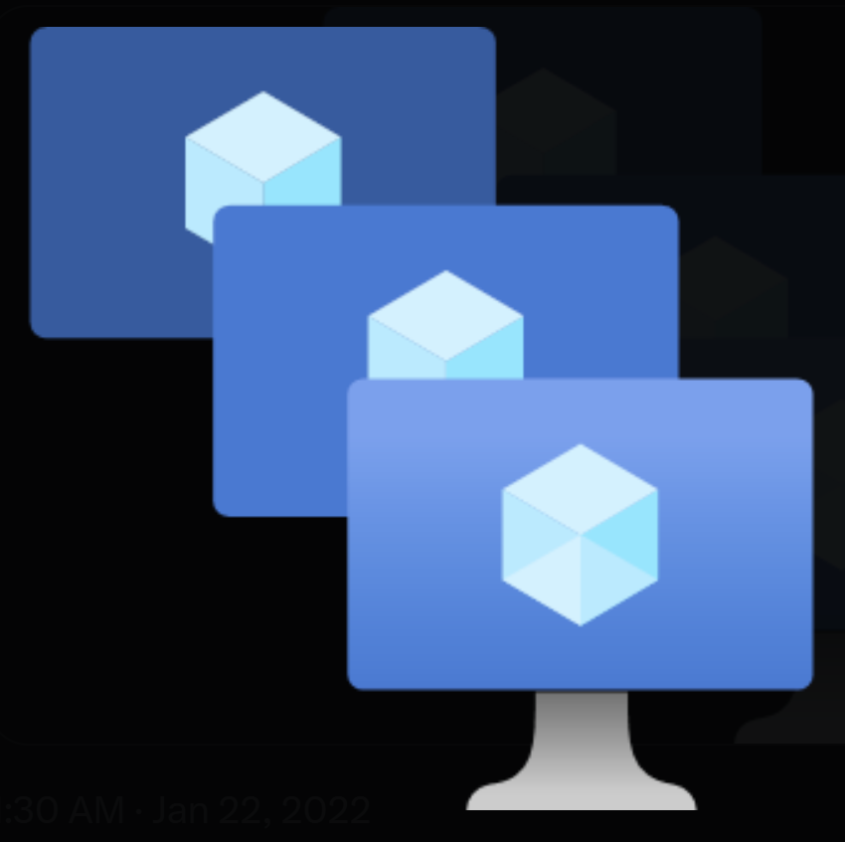
agenda
Definition
Application of VMSS
Why VMSS
Architecture
How it works
Benefits

Slide 3
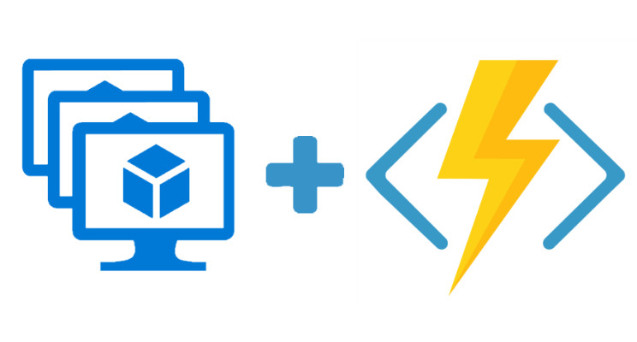
definition
A feature in Azure that enables the deployment and management of a group of identical Virtual Machines
Offers high availability for applications and allows for seamless scaling (Up to 1000 Virtual Machines) in a region or within an Availability Zone
Virtual Machines can be added or removed automatically based on demand or a set schedule
A great choice for workloads that require rapid scaling
Beneficial for applications that have varying levels of traffic or require consistent performance

Slide 4
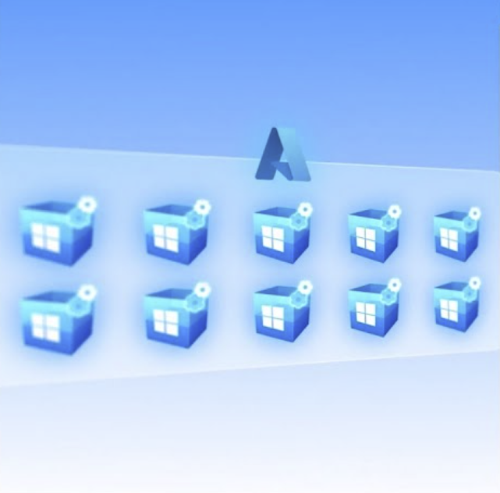
Application of vms
Provides a unified experience across the Azure VM ecosystem
With Flexible orchestration, while remaining fault domain isolation, it scales out the application for
Quorum-based workloads
Open-source databases
Stateful applications
Services that require high availability and large scale
Services that want to mix virtual machine types or leverage Spot and on-demand VMs together
Existing Availability Set applications

Slide 5
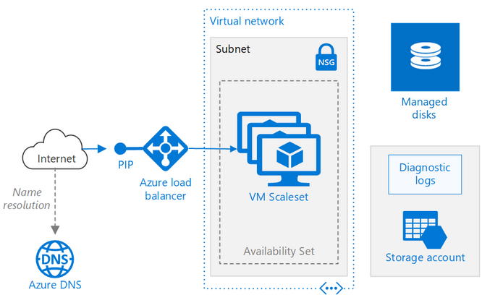
Architecture

Slide 6
Benefits
Scalability
Vertical
Horizontal
Auto scale
Scalable architecture
High Availability
Distribute traffic
Resilience & fault tolerance
Variable Workloads
Cost-Effectiveness
Optimize compute resources
Adjust computational power
Load-balancing
Easy Management
Utilize Azure services
Implement load balancing
Pre-defined rules

Slide 7
Demonstration VMSS Creation Create a rule to automatically scale out Create a rule to automatically scale in Define auto scale instance limits Monitor number of instances in a scale set Auto scale based on a schedule

Slide 8
Thank you !

